Slide 1
Empirical Credit-Risk Management (ECM)
Presentation
To
FMB Group
Credit Union Financial Analytics Ltd
26 July 2013
www.CUFA.ie

Slide 2
Background – ECM Analytics
Research started in 2002
First Desk Top Applications in 2005
Irish Permanent tsb
Bank of Ireland Finance
First Credit Union in 2011
Tullamore Credit Union
Now operating in nine Irish Credit Unions
Ph.D completed in 2012 by Dr Patrick Shallow at CreditExpo, Nova UCD
In parallel:
The Global Banking Crisis took place
IFRS thinking is moving from “incurred loss” to expected loss” accounting.

Slide 3
Traditional Spread Sheet Loss Forecasting for Retail Credit Risk
Loss Forecast %
Months in Arrears
Deficiencies:
Rates are Generic, Fixed, Inaccurate
Well-Performing Portfolio risk not identified

Slide 4
Traditional Mismatch of Income and Risk Recognition
Y1
3.5k
Y2
2.7k
Y3
1.3k
Y4
0.5k
Y5
(1k)
Y6
(1.5k)
Income and Credit Risk
Profit Illusion
Recognition Income/Loss
€8,000
(€2,500)

Slide 5
Comparison of Provisioning Approaches / Loss Probabilities %
% Loss
Forecast
100%
100%
= Resolution 49
90%
= Roll Rate Provisioning
100%
80%
80%
70%
60%
60%
60%
50%
40%
40%
40%
30%
20%
20%
20%
10%
0%
10%
10%
0
1
2
3
4
5
6
7
8
9
10
11
12
Months

Slide 6
ECM Analytics – What it does
Expert Management System measuring retail credit risk objectively
Statistical and Mathematical model
Experience-based Analysis
Individualised to Lender
Standardised Methodology
Based on the Lender’s own most recent experience.

Slide 7
ECM Benefits for Credit Unions
Reduces Bad Debts – by Risk Avoidance
Improves Loan Quality – by Risk Mitigation
Improves Loan Margin – by Appropriate Pricing
Improves Executive Performance – by providing Objective Analyses
Focuses and Directs Credit Control Activity, including developing arrears trends
Compliant Reporting of Provisions and Loan Reviews

Slide 8
ECM Analytics – Some Clients
Consulting:
ECM Analytics Installations:
Bank of Ireland Finance
Credit Unions
Tullamore
Bray,
Cuchullain
Tallaght West
Prison Services
Dundalk
St. Dominic
Navan
ESSCU (in delivery)
Credit Unions
Lombard & Ulster
Reviewing Auditors
KPMG, PwC, FMB, MSN, Whelan Dowling, etc.
Blackrock Consultants (during Bank stress testing)
Notes:
Since 2006,ECM Analytics has, via desk applications been delivering accurate report to banks and their auditors. Today, the enhanced ECM analytics, working off a cloud, delivers far more business intelligence, pricing and risk management information to banks and credit unions.
The product is universal and operates with all currencies and all languages

Slide 9
Traditional Mismatch of Income and Risk Recognition
Y1
3.5k
Y2
2.7k
Y3
1.3k
Y4
0.5k
Y5
(1k)
Y6
(1.5k)
Income and Credit Risk
Profit Illusion
Recognition Income/Loss
€8,000
(€2,500)

Slide 10
Synchronising Risk Recognition with Income Reporting – using ECM Analytics
Y1
Y2
Y3
Y4
0.5k
1.3k
Income and Credit Risk
2.7k
3.5k
0.5k
0.2k
0.8k
1.0k
Recognition
Income & Risk
€2.5k
€1.9k
€0.8k
€0.3k

Slide 11
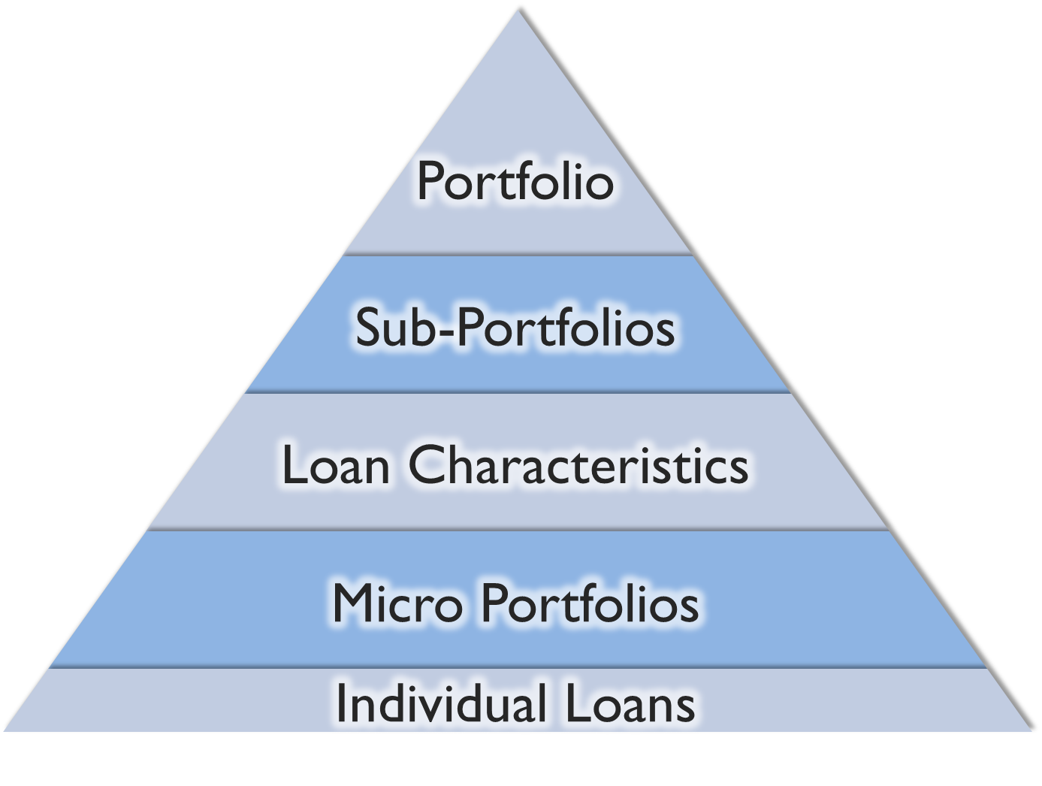
ECM Analytics
Top-Down
Analysis

Slide 12
ECM Analytics - Inputs
Loan characteristics and loan histories
Recovery and Write-off data (LGDs)
Portfolio Age, Maturity and Rate of Attrition
- To calculate Well-Performing Portfolio risk
Portfolio Data & Write-offs
ECM Analytics
Loss Forecasts & Provisions

Slide 13
ECM Analytics - Outputs
Macro Portfolio and Sub-Portfolios
Loss Forecast and Provisions
Trends - short, medium and longer term
Pricing, with Risk Premiums
Analyses by e.g.
car loans, home improvement, students ,maturity, value bands, etc.
Micro Portfolio Analyses
Characteristic combinations
Risk Pricing
Loan Review
Account level analyses
Age & Maturity Analyses
Well-Performing and Arrear loans

Slide 14
Credit Union Data
ECM Analytics
Management Information
Loan Portfolios
Loan Maturities
New Lending Policy
Loan Officers
Credit Control Policy
Rescheduled Loans
Arrear Ages
Risk Rating & Ideal Pricing
Priorities &
Performance
Branch
Performance
Selected Others

Slide 15
ECM Analytics Unique Features
Loss Forecasts and Loss Provisions
Monthly Analyses of All Loan Characteristics
Risk Trend Analyses – 3, 6, 12, 18 months
Rolling Micro Portfolio Analyses with Risk Pricing
Tracking & Analysis of Arrear Migrations
Marked-to-Market Asset Values (where relevant)
Measures Risk in the Well-Performing Portfolio

Slide 16
Benefits
ECM Analytics delivers:
Reduced Bad Debts – Improved Business Viability
Distinguishes Risk and Loan “Hot Spots”
New Lending Targeting and Risk Pricing
Directs marketing focus towards lower risk lending
Focused Credit Control Activity
Risk adjusted exposures
Performance Management
Tracks Underwriting and Credit Control performance
Risk Trend Analyses – Macro & Subsidiary Portfolios
Timely and Accurate Compliance Reporting

Slide 17
Comparison of Provisioning Approaches / Loss Probabilities %
= ECM Analytics - Specimen Community CU Comparison
100%
% Loss
Forecast
= ECM Analytics - Specimen Industrial CU Comparison
101%
100%
= Resolution 49
100%
90%
= Roll Rate Provisioning
80%
80%
70%
60%
60%
60%
50%
40%
40%
40%
30%
20%
20%
20%
10%
6.5%
10%
10%
0%
0
1
2
3
4
5
6
7
8
9
10
11
12
Months
Note: The shape and significance of the ECM Analytics curve will depend on the experience of each individual Credit Union.

Slide 18
Sample Comparison Forecasts
 | Current | 1 month | 2 Months | 3 Months | 4 Months | 5 Months | 6 Months | Total | %
Actual | 15,000k | 1,300k | 700k | 500k | 400k | 300k | 2,640k | 20,840k

Slide 19
Sample Comparison Forecasts
 | Current | 1 month | 2 Months | 3 Months | 4 Months | 5 Months | 6 Months | Total | %
Actual | 15,000k | 1,300k | 700k | 500k | 400k | 300k | 2,640k | 20,840k
Res.49 | 0% | 0% | 10% | 10% | 20% | 20% | 40%
Res.49 | 0 | 0 | 70k | 50k | 80k | 60k | 1,056k | 1,316k

Slide 20
Sample Comparison Forecasts
 | Current | 1 month | 2 Months | 3 Months | 4 Months | 5 Months | 6 Months | Total | %
Actual | 15,000k | 1,300k | 700k | 500k | 400k | 300k | 2,640k | 20,840k
Res.49 | 0% | 0% | 10% | 10% | 20% | 20% | 40%
Res.49 | 0 | 0 | 70k | 50k | 80k | 60k | 1,056k | 1,316k
RRP | 0% | 0% | 10% | 20% | 40% | 60% | 80%
RRP | 0 | 0 | 70k | 100k | 160k | 180k | 2,640k | 3,150k

Slide 21
Sample Comparison Forecasts
 | Current | 1 month | 2 Months | 3 Months | 4 Months | 5 Months | 6 Months | Total | %
Actual | 15,000k | 1,300k | 700k | 500k | 400k | 300k | 2,640k | 20,840k
Res.49 | 0% | 0% | 10% | 10% | 20% | 20% | 40%
Res.49 | 0 | 0 | 70k | 50k | 80k | 60k | 1,056k | 1,316k
RRP | 0% | 0% | 10% | 20% | 40% | 60% | 80%
RRP | 0 | 0 | 70k | 100k | 160k | 180k | 2,640k | 3,150k
ECM | 6.54% | 22.33% | 33.72% | 53.18% | 55.89% | 93.88% | 97.80%
ECM | 981k | 290k | 236k | 265k | 223k | 281k | 2,582k | 4,858k

Slide 22
Sample Comparison Forecasts
 | Current | 1 month | 2 Months | 3 Months | 4 Months | 5 Months | 6 Months | Total | %
Actual | 15,000k | 1,300k | 700k | 500k | 400k | 300k | 2,640k | 20,840k
Res.49 | 0% | 0% | 10% | 10% | 20% | 20% | 40%
Res.49 | 0 | 0 | 70k | 50k | 80k | 60k | 1,056k | 1,316k
RRP | 0% | 0% | 10% | 20% | 40% | 60% | 80%
RRP | 0 | 0 | 70k | 100k | 160k | 180k | 2,640k | 3,150k
ECM | 6.54% | 22.33% | 33.72% | 53.18% | 55.89% | 93.88% | 97.80%
ECM | 981k | 290k | 236k | 265k | 223k | 281k | 2,582k | 4,858k

Slide 23
Sample Comparison Forecasts
 | Current | 1 month | 2 Months | 3 Months | 4 Months | 5 Months | 6 Months | Total | %
Actual | 15,000k | 1,300k | 700k | 500k | 400k | 300k | 2,640k | 20,840k
Res.49 | 0% | 0% | 10% | 10% | 20% | 20% | 40%
Res.49 | 0 | 0 | 70k | 50k | 80k | 60k | 1,056k | 1,316k | 27.1%
RRP | 0% | 0% | 10% | 20% | 40% | 60% | 80%
RRP | 0 | 0 | 70k | 100k | 160k | 180k | 2,640k | 3,150k | 64.8%
ECM | 6.54% | 22.33% | 33.72% | 53.18% | 55.89% | 93.88% | 97.80%
ECM | 981k | 290k | 236k | 265k | 223k | 281k | 2,582k | 4,858k | 100.0%

Slide 24
Benefits
ECM Analytics delivers:
Reduced Bad Debts – Improved Business Viability
Distinguishes Risk and Loan “Hot Spots”
New Lending Targeting and Risk Pricing
Directs marketing focus towards lower risk lending
Focused Credit Control Activity
Risk adjusted exposures
Performance Management
Tracks Underwriting and Credit Control performance
Risk Trend Analyses – Macro & Subsidiary Portfolios
Timely and Accurate Compliance Reporting

Slide 25
ECM Analytics
Mike Kitchen
Chairman
Ralph Swoboda
Managing Director
Pintu Jacob
IT Director
Declan Mooney
Commercial Director

